Slide 1

Domain Application and Predictive Analysis for Data Science Salaries Group A
Team Members:-
Mohammad Saad Shaikh-22163573
Harshal Agashe-22157051
Ananya Kachawa- 21136751

Slide 2
INTRODUCTION & MOTIVATION
This study focusing on analyzing salary trends in the data science field. Employing machine learning techniques such as linear regression, random forest, and XGBoost, the study provides accurate salary predictions. The findings contribute valuable insights into factors influencing compensation, benefiting professionals, organizations, and policymakers. The transparent methodology ensures reliability and reproducibility for further exploration and strategic decision-making in talent acquisition and salary benchmarking
The utilization of the dataset is motivated by the recent strides made in the field of machine learning algorithms, which hold the potential to enhance decision-making and problem-solving across various industries. The efficacy of these algorithms relies heavily on the quality and characteristics of the employed data. Hence, comprehending the performance of these algorithms on diverse datasets is paramount.

Slide 3
RESEARCH QUESTIONS
How precise are the salary projections made using machine learning algorithms and the dataset?
How accurate and precise were the results of the various machine learning techniques on the dataset?
What conclusions can be drawn from the performance assessment of machine learning algorithms on the dataset, and how can this knowledge assist organisations in making decisions regarding hiring new employees, salary benchmarking, and negotiating support?

Slide 4
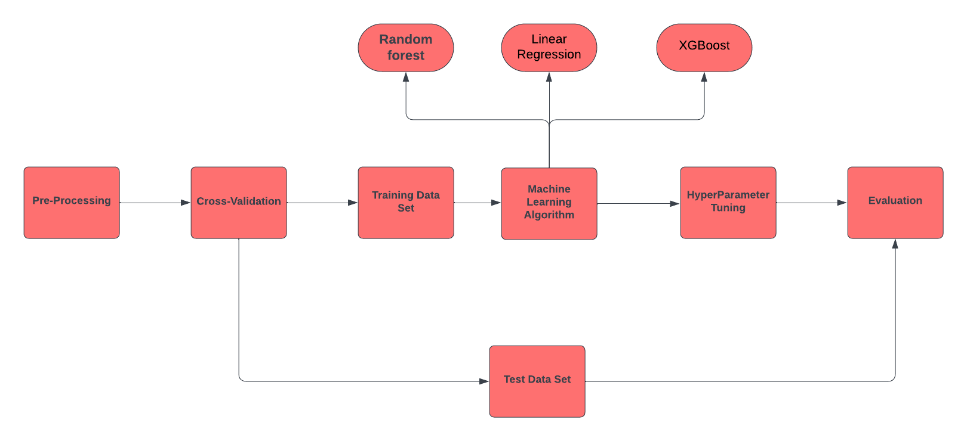
METHODOLOGY

Slide 5
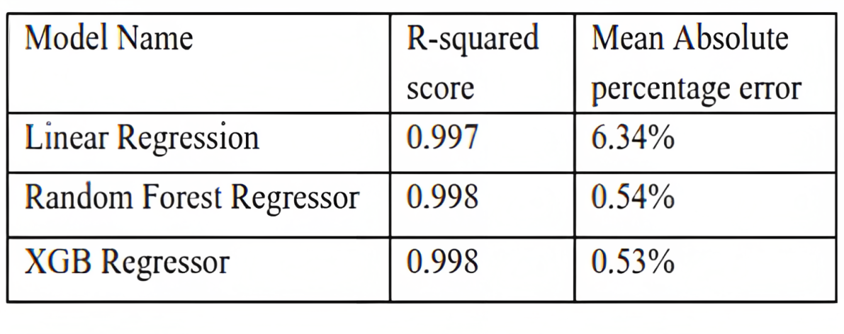
Model Selection & Evaluation
For linear regression, a simple linear model with appropriate feature encoding and regularization techniques have been used. Random forest and XGBoost are ensemble methods that utilize decision trees. The architecture of these models includes multiple decision trees with techniques like bagging and boosting to enhance performance and reduce overfitting.
Mean squared error (MSE), root mean squared error (RMSE), and R-squared were used to measure the performance of the models in relation to regression tasks. The models' predictions were compared with the actual salary values to assess their accuracy and predictive power.

Slide 6

BUSINESS VALUE
Salary Benchmarking: Organisations can use our model to estimate salary during talent acquisition with respect to candidate’s experience, job type and other relevant factors. This can help the stay competitive and fair on salary offerings. This way they can attract and retain top talents.
Negotiation Support: Salary predictions can provide guidance to data science professionals during salary negotiations with organisations. Having insights into salary ranges based on factors such as skills, experience, and location helps in having informed discussions HR mangers.
Decision Making: With the insights gained from our model, executives can make better business decision in terms of workforce planning, budgeting, strategy and resource allocation.

Slide 7

CONCLUSIONS
In conclusion, this research project focused on analyzing and predicting data science salaries in the year 2023. The dataset provided valuable insights into the factors influencing salary outcomes in the field of data science. Three machine learning models, namely Linear Regression, Random Forest Regressor, and XGBoost, were employed for salary prediction. Results showed that all models performed exceptionally well, with XGBoost demonstrating slightly higher accuracy and better feature importance measures. The findings highlight the significance of machine learning in predicting salaries accurately and identifying key factors affecting salary outcomes. Future work could involve exploring additional feature engineering techniques and incorporating more advanced algorithms to further enhance salary prediction accuracy. Overall, this study contributes to the understanding of data science salaries and provides valuable implications for salary benchmarking, negotiation support, and decision-making in the field of data science.

Slide 8
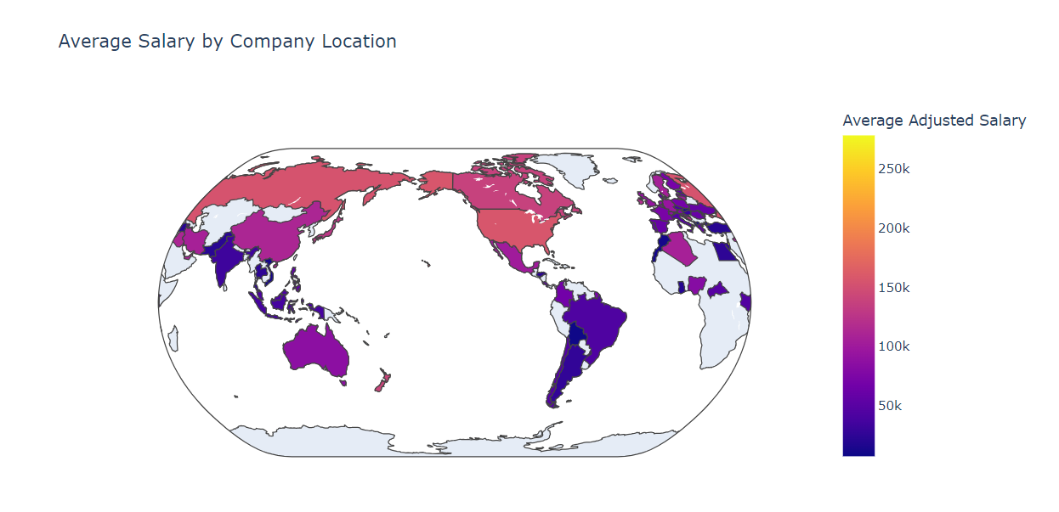
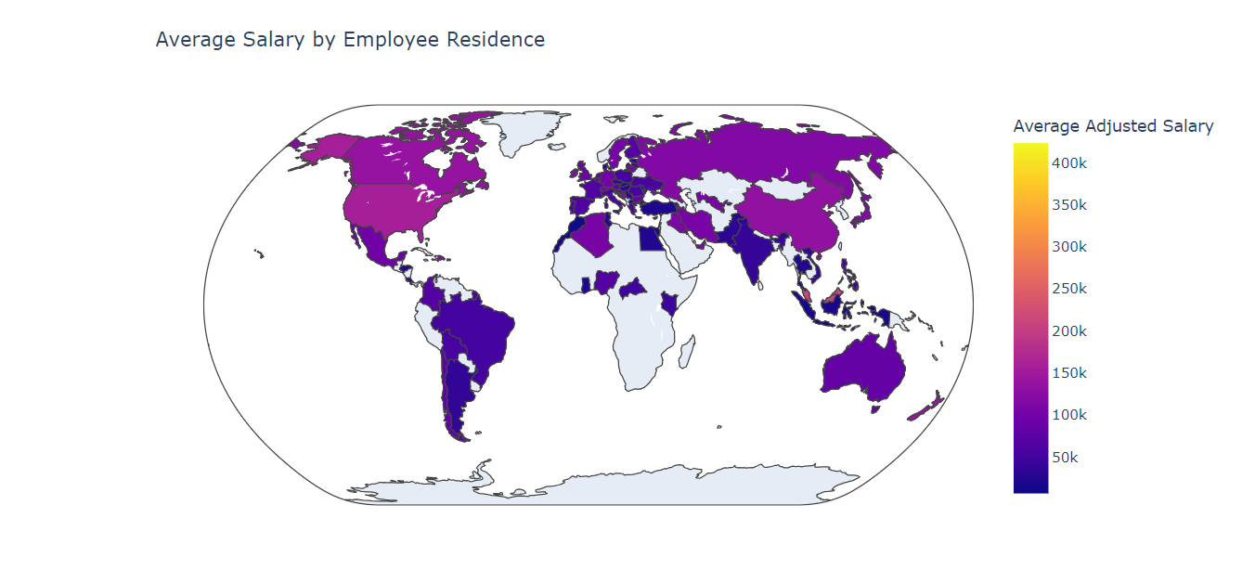
3D Model

Slide 9
Acknowledgment
We want to sincerely thank Prof.Qurrat Ul Ain for giving me the chance to work on this project, and We want to show my gratitude to her.
Thank You

